Slide 1
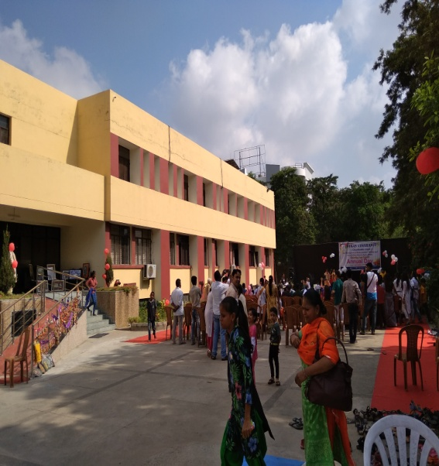
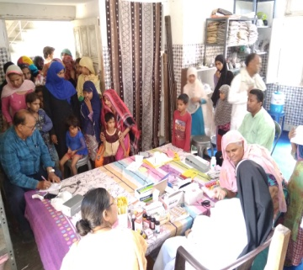
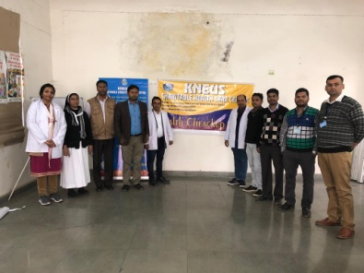
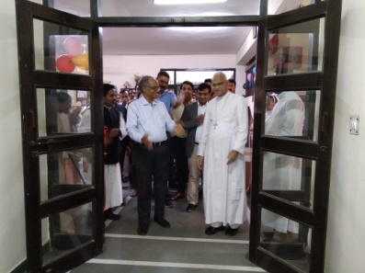
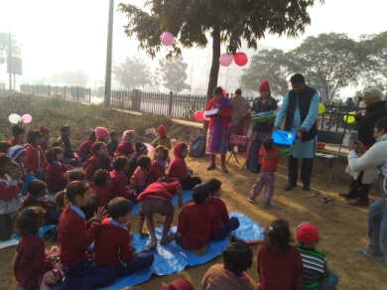
KNEUS
Kusht Niyantran Evum Unmoolan Samiti
Annual Report
2019
A healthy and Happy Society

Slide 2
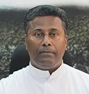
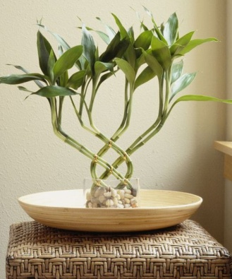
Executive Director Message
The Very purpose of creating KNEUS Society with noble vision & mission is to Work for the eradication of deadly diseases like leprosy, TB, HIV and other communicable and contagious sickness mainly among the poor and marginalised people.
We have a pivotal role to play as the torch bearers of the Society with core values towards facilitating communities an effective and sustainable health care initiatives to social empowerment and healing touch to make difference in the lives of the needy.
I really appreciate and congratulate our staff and well wishers for their commitment and hard work for the wellbeing of the poor and needy.
Rev. Fr. Sebastian Kollithanam
KNEUS, Greater Noida
Kusht Niyantran Evum Unmoolan Samiti
www.kneus.in

Slide 3
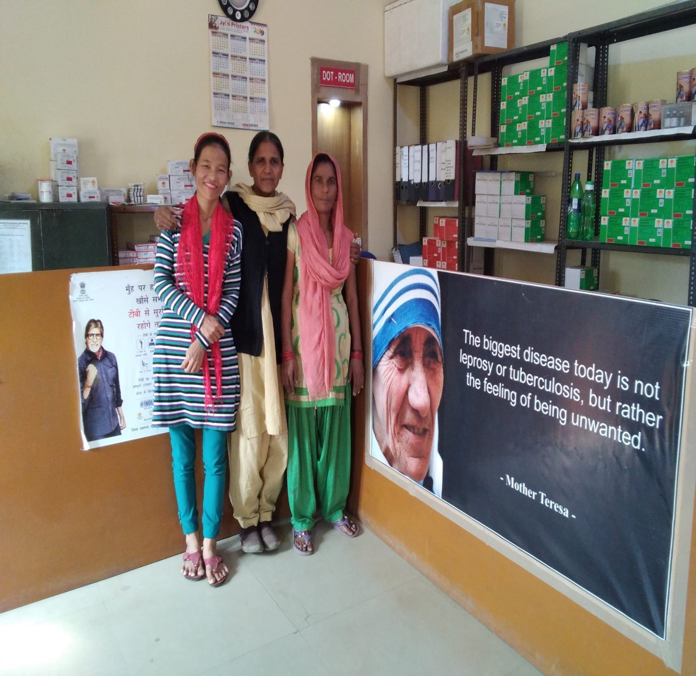
OBJECTIVE
To collaborate and work towards the achievement of the national aim of controlling and eliminating leprosy, tuberculosis and other communicable diseases.
VISION
A healthy and Happy Society
MISSION
To Promote health excellence by empowering individuals to take ownership of their health.
Kusht Niyantran Evum Unmoolan Samiti
www.kneus.in

Slide 4
Content
1
Introduction
2
Where we work
4
3
Leprosy
Tuberculosis & HIV
5
General Health camp & awareness Program
7
6
Our Partner
Our Impact
8
Major Developments
9
Financial Statement
Kusht Niyantran Evum Unmoolan Samiti
www.kneus.in

Slide 5
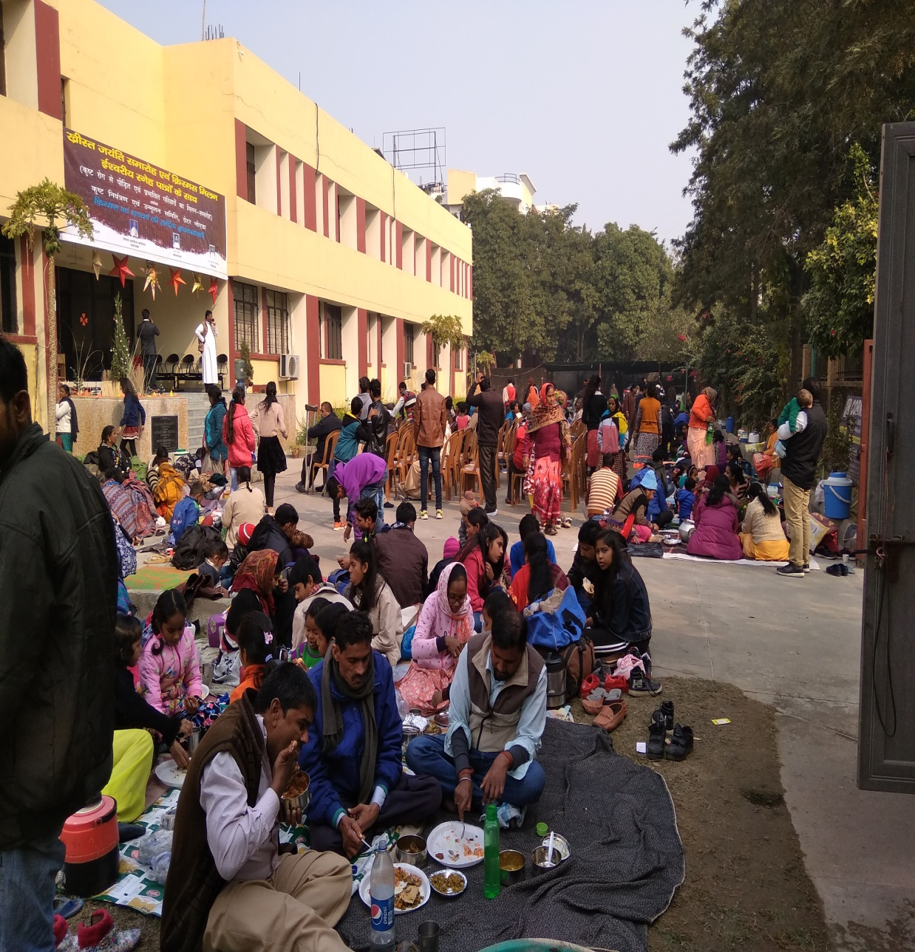
Introduction
KUSHT NIYANTRAN EVUM UNMOOLAN SAMITI (KNEUS) is a registered voluntary organization working for Leprosy, HIV/AIDs, Tuberculosis and other communicable diseases in the states of Uttar Pradesh, Uttrakhand and Delhi for almost three decades. In the year 1987, KNEUS started working in 57 leprosy colonies in the western UP and treated over 5,000 leprosy patients. In 1992, this work was extended to villages and cities. This program was carried out through door to door surveys and health education programs, patients were detected and treated. This is evident from the fact that nearly 49,720 numbers of medical interventions for leprosy affected person were taken up. The leprosy focused services carried out by the organization have been extended to tuberculosis after integration of leprosy treatment into general health in 2003. The systematic and scientific approach planned and implemented by KNEUS has yielded desired result in several folds. KNEUS started 9 DMCs under RNTCP project NGO/Private Provider/PPP Partner in 2003 in urban slums and remote areas. It has registered and treated 28,038 Tuberculosis patients till 2018 December.
KNEUS is a member of STOP TB Partnership. Now KNEUS is having two DMCs in Noida & Salarpur district Gautam Buddh Nagar and the head office facilitated Five Bed Charitable Hospital, Automatic Pathology lab, Physiotherapy, Dental care, TB Care, Therapeutic & Rehabilitation Centre for differently abled children.
Kusht Niyantran Evum Unmoolan Samiti
www.kneus.in

Slide 6
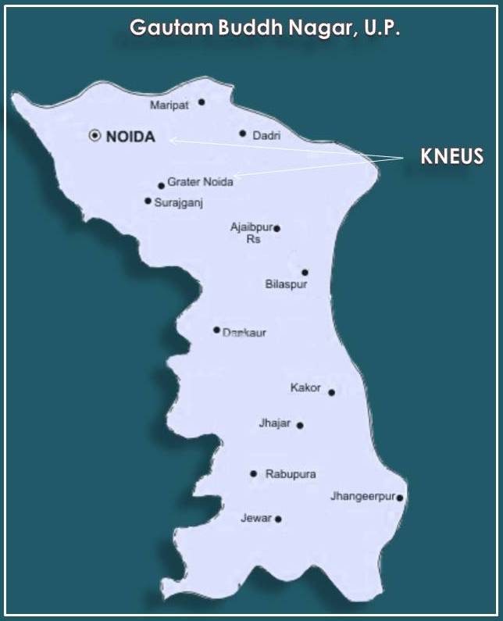
Where we work
DMC SEC -10,NOIDA G.B.Nagar
Situated on Delhi and Ghaziabad border fully factory urban slums area. Total population covered 1.5 lakh. KNEUS has a Designated Microscopic Center (DMC) of Revised National Tuberculosis Control Program (RNTCP) under Public Private Partnership with the Government of U.P.in Sector 10,Gautham Budha Nagar district since 2003. This center covers more than l.5 lakh population in Noida region. This area is in National Capital Region (NCR), about 30 sq. km composed of old city slums & villages. In this area majority of the population are living in rented houses. These people are migrants from the other states of India. They are socially and economically backword.
KNEUS DMC is covering the sectors and villages- Sec-1, sec-2, sec-3, sec-4, Harola,sec-5, sec-6, sec-7, sec-8, sec-9,sec-10,Jhundpura, Sec-11,sec12,sec-13, sec-14,Nayabans, sec-15, sec-16 and Sec-17. “Slums juggies attached with Sec-5, Sec-8, Sec-9, Sec-10, Sec-11, Sec-15 and Sec-16.”
DMC Salarpur ,G.B.Nagar : There are labourer class migrated population from other states in this area. Total population covered in this area 1 lakh. Salarpur is covering the sectors and villages-Salarpur, sec-101, Sec-104,sec-79,Sec-113, Sec-80,kakrala, Nagala, sec-81, Sec-84, Sec -87, Yakubpur, Sec-89,Ilabansh, Sec138 and Gejha.
KNEUS CHARITABLE HOSPITAL: Knowledge Park-1, Greater Noida.
Kusht Niyantran Evum Unmoolan Samiti
www.kneus.in

Slide 7
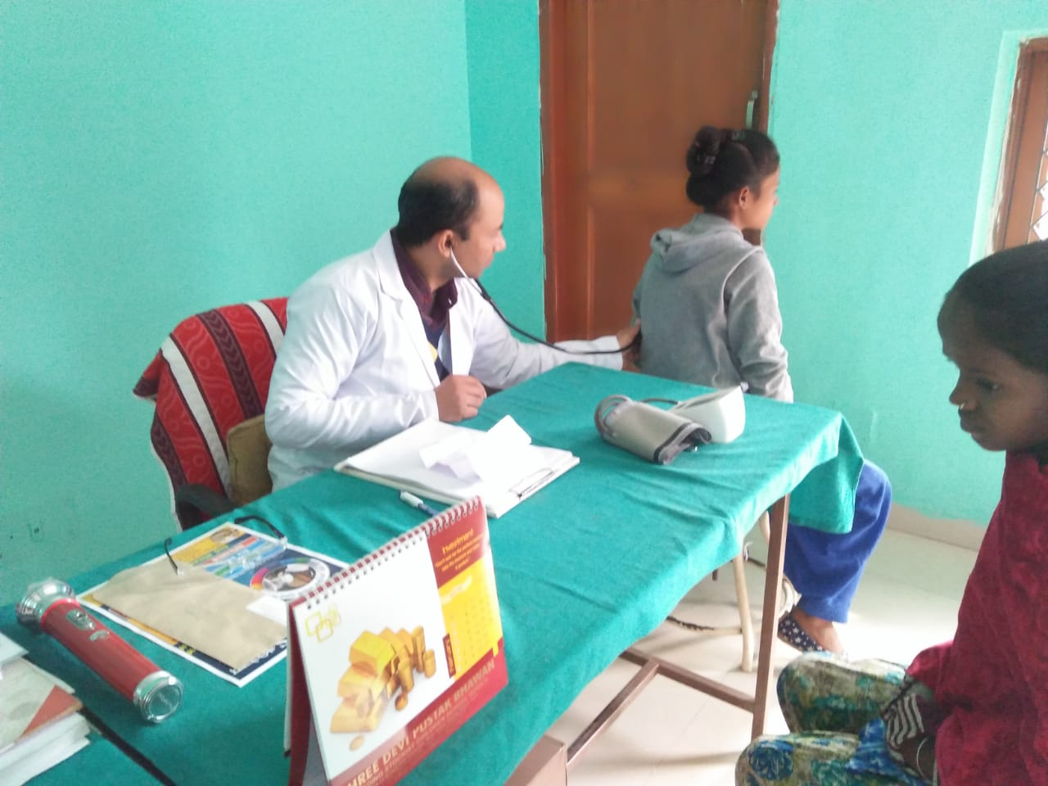
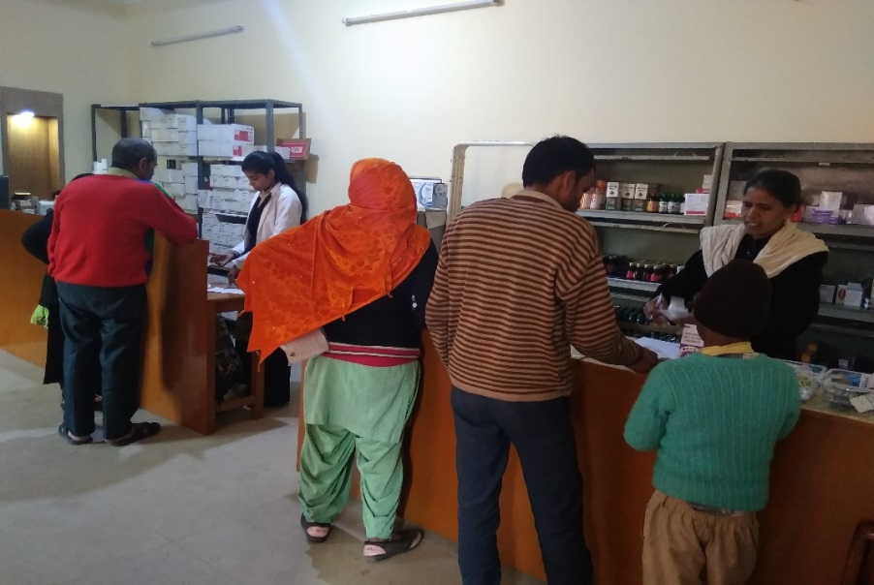
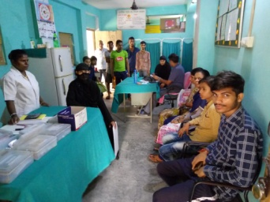
Support towards Tuberculosis End
Medical Intervention:
Primary level health care
OPD-Daily Diagnosis
Pathology Lab
Designated Microscopy Centre-Sputum tests of the suspected patients.
DOTs Centre-Monitoring of the treatments-Daily Regimen.
Enrolment and follow up of TB patients under Nikshay.
Counselling & Refer of patients to ICTC Centre for HIV/AIDS test.
Address verification of the registered patients through home visits by health workers.
Case Detection
(1st January, 2019 to
31st December, 2019)
Indicators | Salarpur | Sec10 | Total
Number of Patient in OPD. | 4288 | 9226 | 13514
No. of suspect examined | 858 | 1143 | 2001
No.of Smear positive cases among suspect. | 127 | 185 | 312
% of Smear positive cases among suspect. | 14.8% | 16.2% | 15.5%
New Smear Sputum Positive diagnosed. | 108 | 144 | 252
Total patient registered for treatment. | 312 | 517 | 829
Medical Intervention:
OPD-Daily Diagnosis
Pathology Lab
Designated Microscopy Centre-Sputum tests of the suspected patients.
DOTs Centre-Monitoring of the treatments-Daily Regimen.
Enrolment and follow up of TB patients under Nikshay.
Counselling & Refer of patients to ICTC Centre for HIV/AIDS test.
Address verification of the registered patients through home visits by health workers.
Community level meeting.
Awareness creation programs
Kusht Niyantran Evum Unmoolan Samiti
www.kneus.in

Slide 8
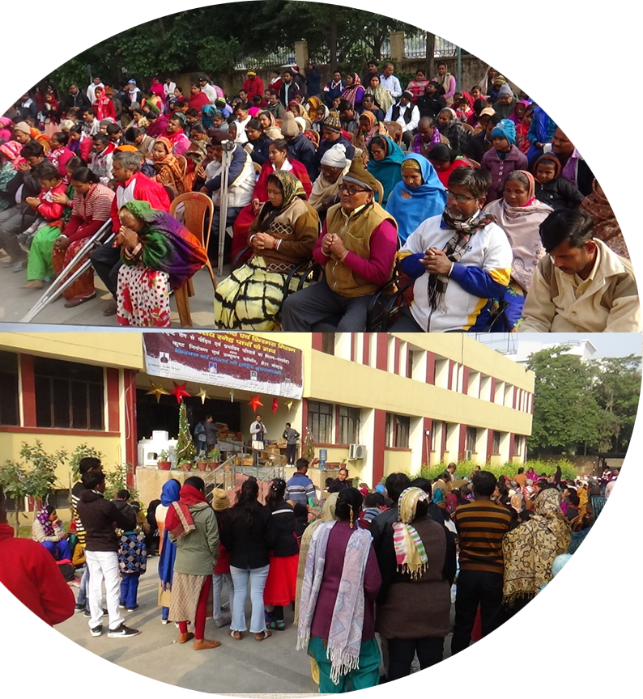
Work towards People with Disability due to Leprosy
“A get-together for the families Affected by Leprosy ”
Kusht Niyantran Evum Unmoolan Samiti (KNEUS) is a home for all leprosy affected people. KNEUS organizes gathering on Christmas day and new year celebration every year for leprosy affected families. On this awaited day all participants from different leprosy colonies of Punjab, Haryana, Bihar, Uttrakhand, Uttar Pradesh and Delhi were there to share the joyful occasion.
On this get together KNEUS provides materials for their daily survivals like foodstuff, cloths, educational materials and Self care kits for leprosy affected people.
No. of Leprosy affected families attend- 200
Kusht Niyantran Evum Unmoolan Samiti
www.kneus.in

Slide 9
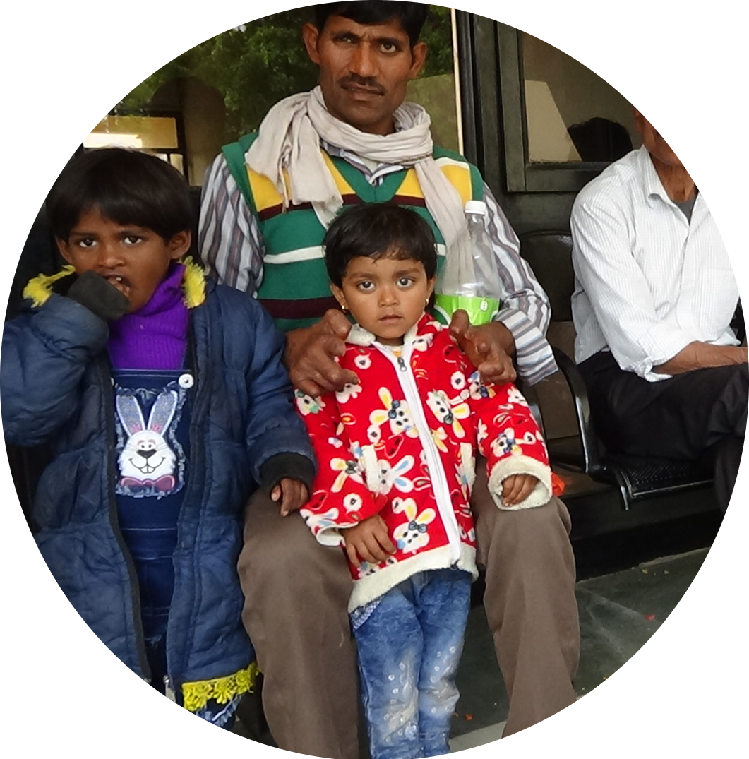
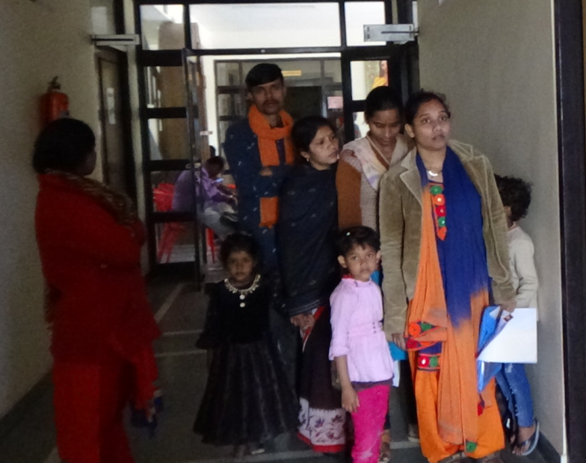
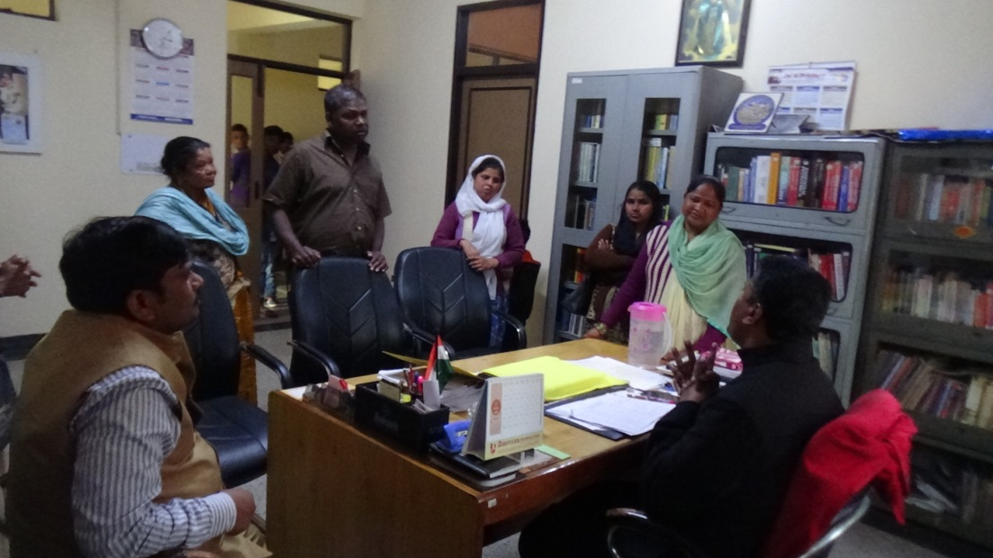
Work towards People with Disability due to Leprosy
EDUCATIONAL SUPPORT TO CHILDREN OF LEPROSY AFFECTED FAMILIES
The present activity for the Leprosy affected families . Every year the KNEUS recruits children from nearby leprosy colonies with in collaboration of Fr. Agnel Balbhawan Greater Noida for their education. With the generosity of Fr. Agnel Balbhawan KNEUS gets 15 seats in the school for the future of the children in buildup.
Kusht Niyantran Evum Unmoolan Samiti
www.kneus.in

Slide 10
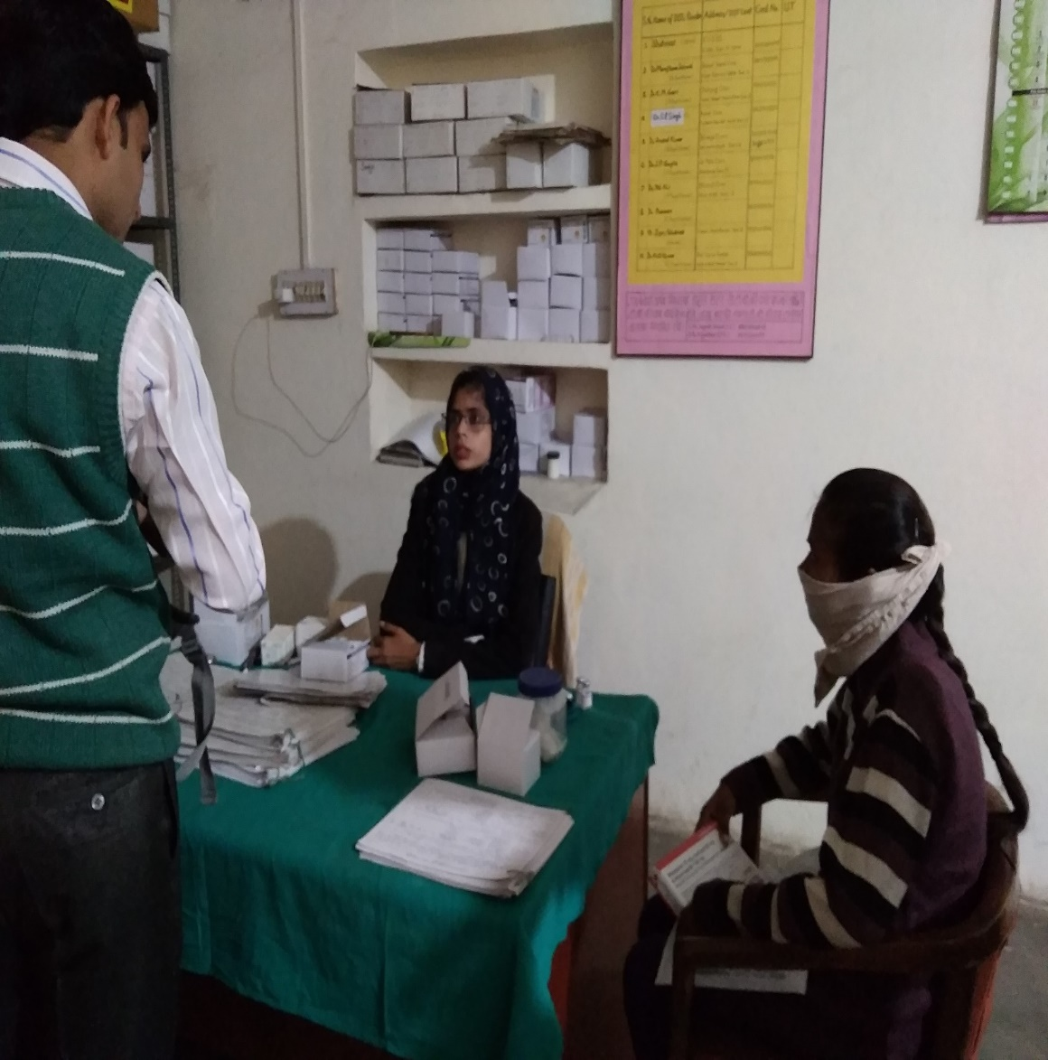
HIV
Our health worker/ DOTS supporter provide counselling to all confirmed TB patient and sent Integrated Counselling and Testing Centres (ICTC) for test before registration.
HIV counselling and testing service is a key entry point to prevention of HIV infection as well as the treatment and care for the people who are infected with HIV. Because of our availability for counselling and testing services, people can access accurate information about HIV prevention and care and undergo HIV test in a supportive and confidential environment. People who are found HIV negative are supported with information and counselling to reduce risks and remain HIV negative. People who are found HIV positive are provided psycho-social support and given a proper treatment and care.
No. of Patient undergoing counselling &HIV Test- 805
Kusht Niyantran Evum Unmoolan Samiti
www.kneus.in

Slide 11
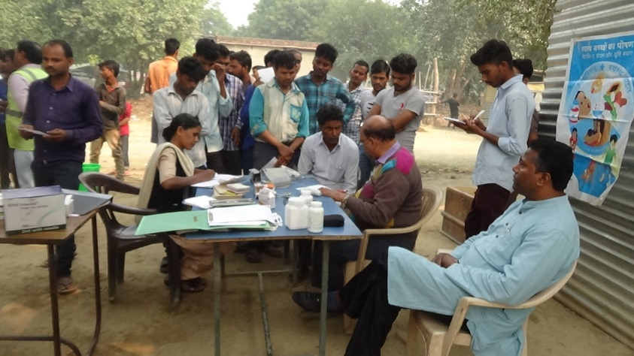
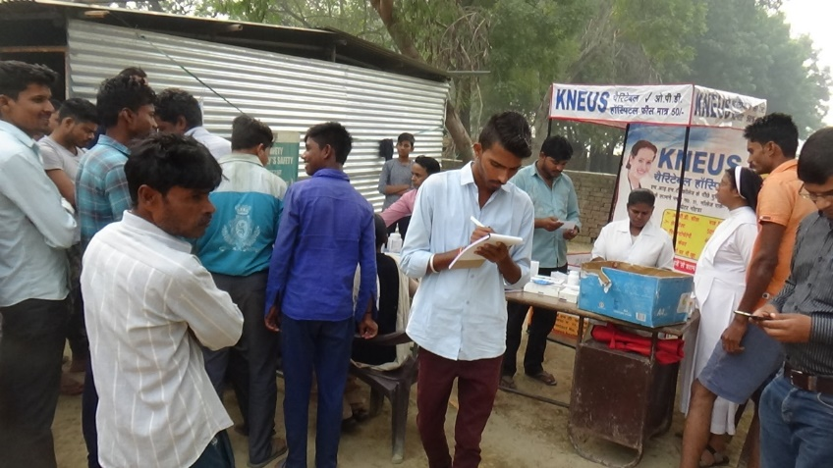
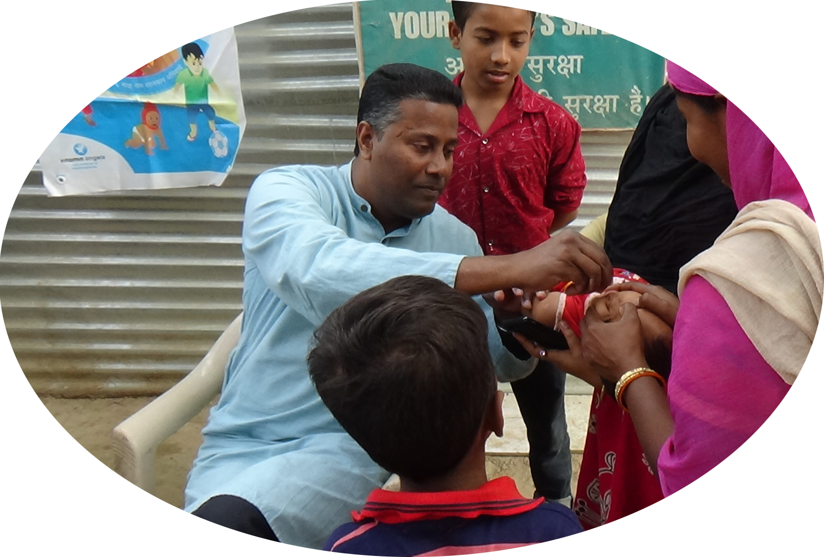
Health Camp & Awareness Program
HEALTH CAMP:
Kneus have organize health camps in urban and rural village and distribute free medicine, blood sugar test and free consultant. Number of health Camps organised-25 &Numbers of person benefitted- 3250
VITAMIN
A SUPPLEMENTATION AND DEWORMING
We with the help of Vitamin Angels Ngo group providing Vitamin A capsule to children free of cost.
Number of children benefitted with Vitamin A supplement & Deworming-1768
Kusht Niyantran Evum Unmoolan Samiti
www.kneus.in

Slide 12
Our Impact
TB
Leprosy
No. of suspect
examined-2001
Total patient registered for treatment-829
HIV
Educational support to children of leprosy affected families
The Children admitted to the boarding school is almost: 135
Number of patient counseling and sent to ICTC for HIV TEST- 805
Primary health care services
Number of patient in OPD-
13514
Kusht Niyantran Evum Unmoolan Samiti
www.kneus.in

Slide 13
Our Partner and Contribution
Regional
Bishop House ,Agra
Since Five years continuously
financial support is being given to our Gr. Noida
Center for General Health Care Service & Charitable Pathology lab test benefitting to the surrounding needy people.
St. Joseph’ s School,
Greater Noida
Jesus Mary
& Convent School,
Greater Noida
Since 3 years St. Joseph’s School has been providing constantly
financial support to our Center at Sec 10,
Noida for Tuberculosis elimination as well as General Health Care Service benefitting to the surrounding needy people.
Since 3years Jesus & Mary Convent School has been continuously helping
financial support to our Center at Salarpu Noida for Tuberculosis elimination as well as General Health Care
Service benefitting to the
surrounding needy people.
Fr. Agnel School,
Greater Noida
Since 15 years Fr. Agnel School has been providing excellence education with boarding facility to children from Leprosy Affected Families through our organization.
Kusht Niyantran Evum Unmoolan Samiti
www.kneus.in

Slide 14
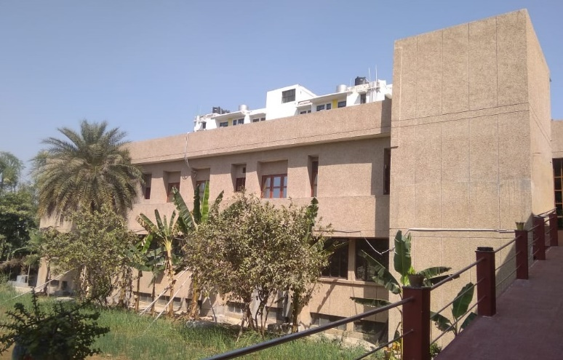
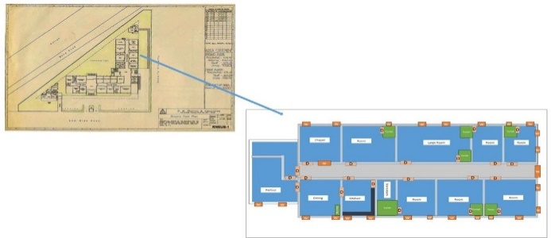
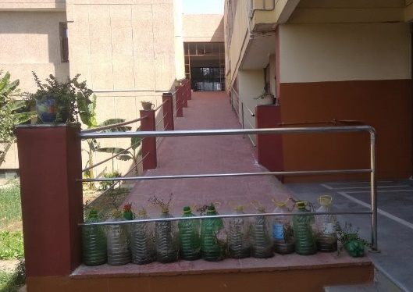
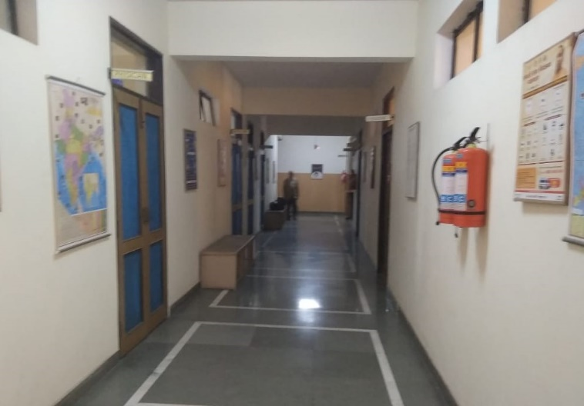
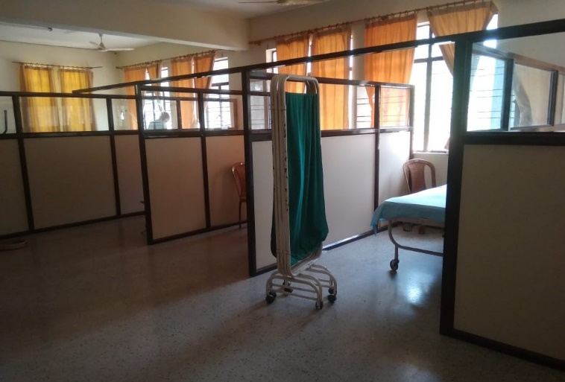
Major developments
BUILDING CONSTRUCTION:
KNEUS has completed construction work of 1st Floor convent block contains 7 bedrooms with toilet attached, kitchen, dining room, chapel and Parlour.
RAMP CONSTRUCTION:
KNEUS has constructed a RAMP from Ground floor to 1st Floor.
UPGRADATION OF DISPENSARY CONSISTS OF 5 BEDS HOSPITAL
Kusht Niyantran Evum Unmoolan Samiti
www.kneus.in

Slide 15
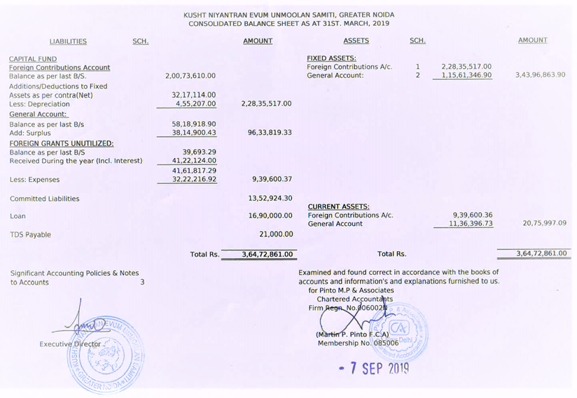
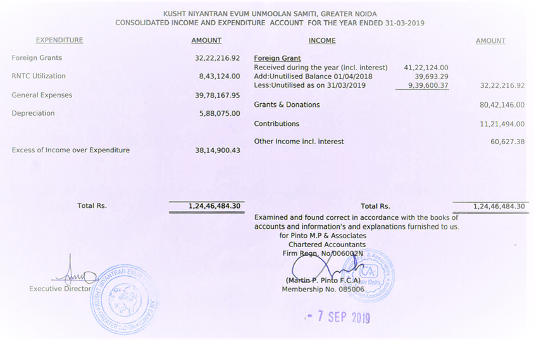
Financial Statement
Kusht Niyantran Evum Unmoolan Samiti
www.kneus.in

Slide 16
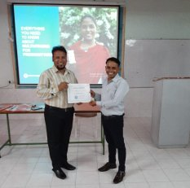
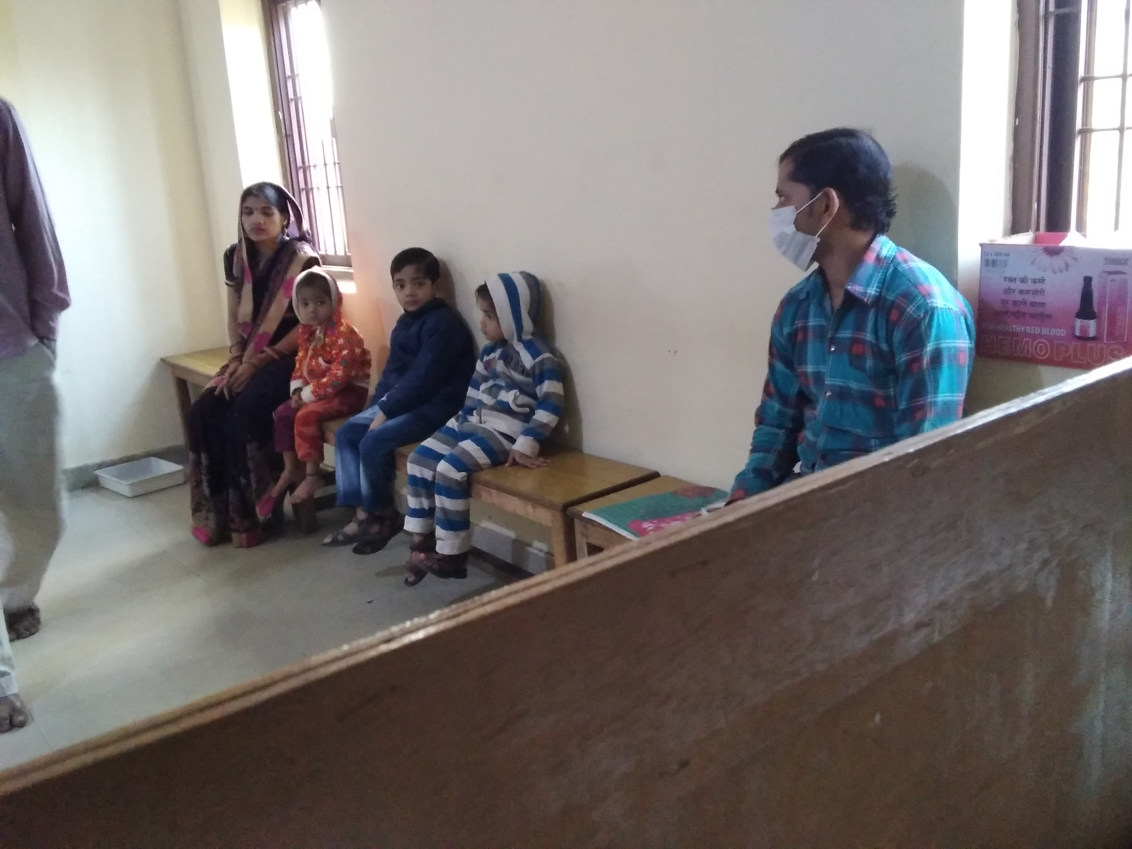
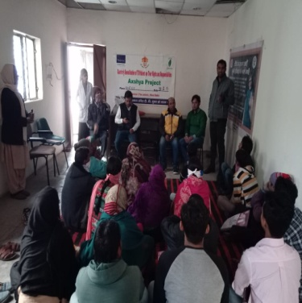
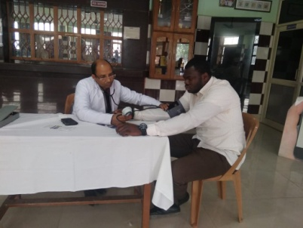
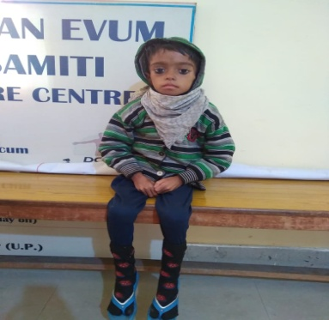
11
Plot No. 11, Knowledge Park-1,
Greater Noida, Gautam Buddh Nagar
U.P.-201310
Email-kneusgnoida@gmail.com, www.kneus.in

